Slide 1
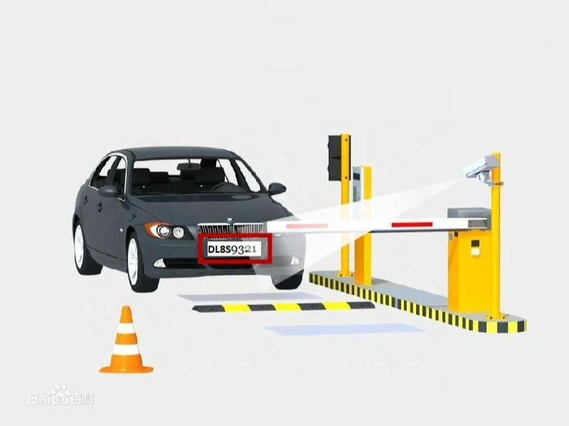
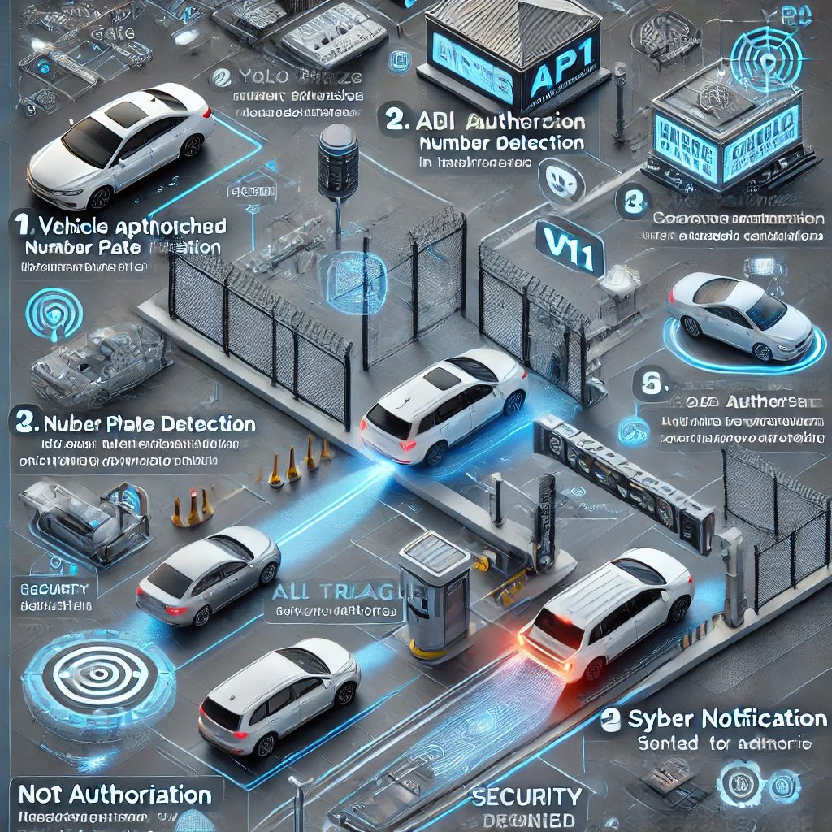
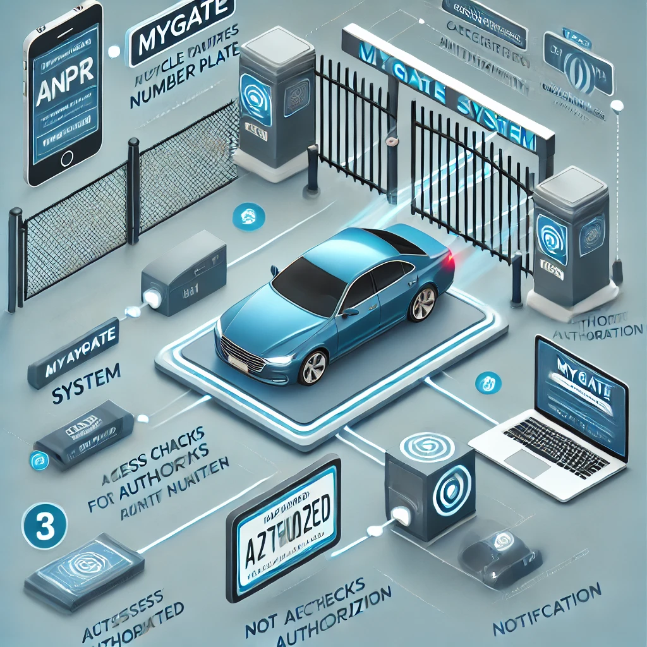
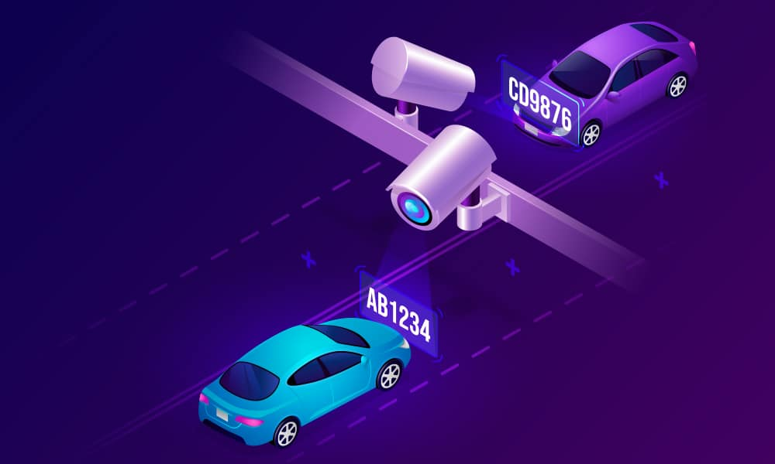
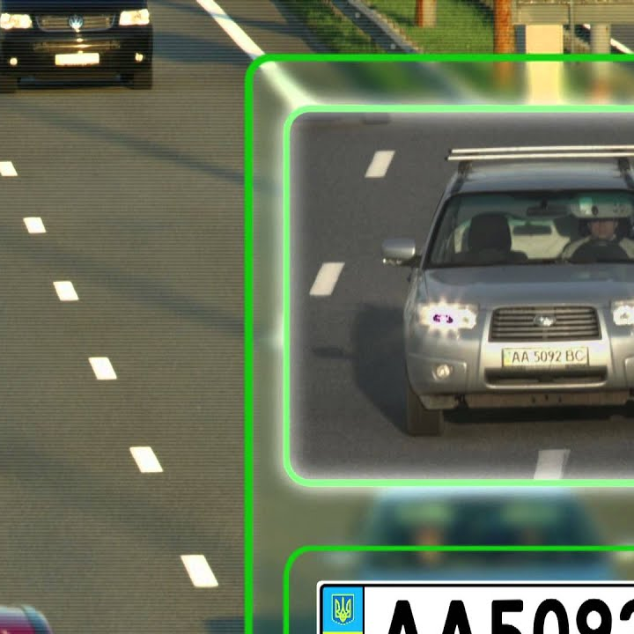
AUTOMATIC
NUMBER PLATE
RECOGNITION
USING BLOCKCHAIN
SIDDHARTH SINGH
SARTHAK
VAIBHAVDEEP BHATT

Slide 2
DECENTRALIZED SYSTEM ARCHITECTURE
ICP
Smart
Contract
User Device
Consensus Mechanism
Another User Node
Blockchain Ledger
Block Validation

Slide 3
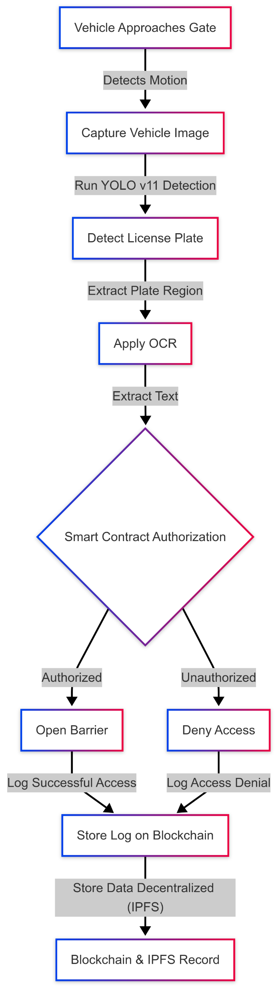
BLOCKCHAIN-POWERED VEHICLE ACCESS CONTROL SYSTEM
SECURE SMART CONTRACT AUTHORIZATION
The license plate data is verified using blockchain-powered smart contracts, ensuring secure access control.
AUTOMATED VEHICLE DETECTION
The system uses motion sensors and AI-based image recognition to detect and capture vehicle details accurately.
IMMUTABLE DATA STORAGE
All access logs are securely stored on the blockchain and decentralized IPFS, ensuring transparency and security.
SEAMLESS GATE OPERATION
Once verified, authorized vehicles are granted entry, while unauthorized access is automatically denied.

Slide 4
AUTOMATED VEHICLE ACCESS CONTROL USING BLOCKCHAIN
SECURE
&
AUTOMATED VEHICLE ACCESS
Our system leverages AI-driven License Plate Recognition (LPR) and blockchain-based authentication to automate vehicle access. Using real-time image processing, the system identifies license plates, verifies credentials via smart contracts, and ensures secure, tamper-proof entry management.
Experience the future of smart parking with AI & Blockchain integration.

Slide 5
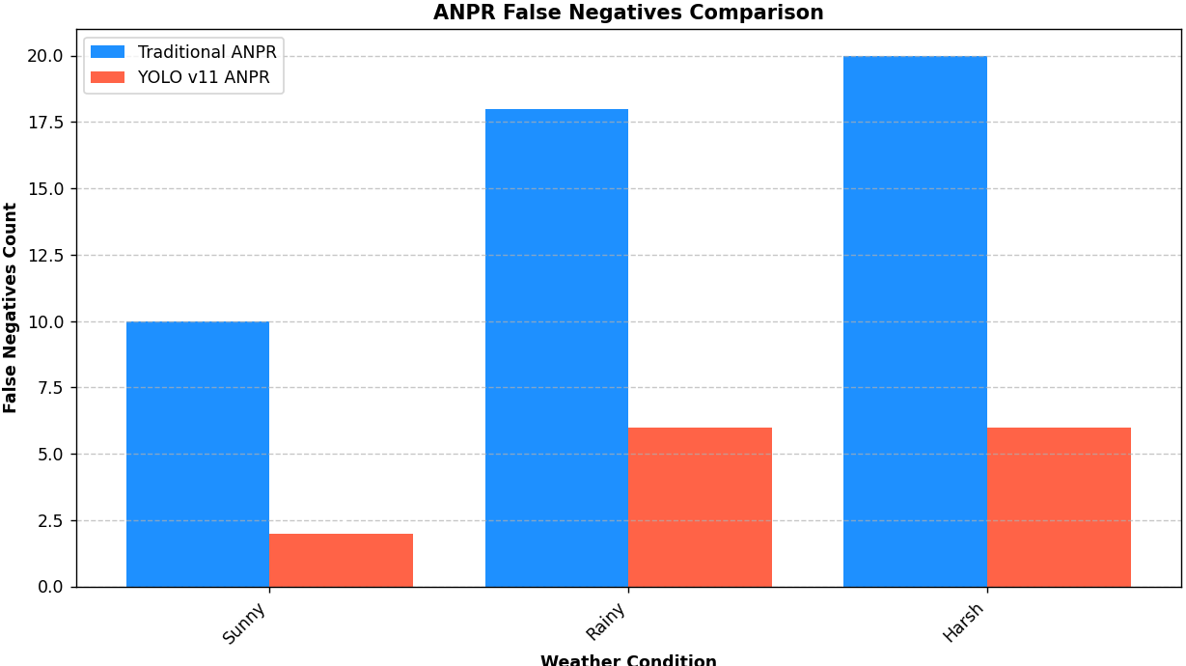
AI-DRIVEN VEHICLE ACCESS: PERFORMANCE ANALYSIS
License Plate Recognition Accuracy
Our AI-powered ANPR system ensures high-accuracy license plate recognition, reducing errors in harsh conditions by leveraging YOLO v11-based deep learning models
Blockchain-Powered Access Control
Blockchain-based authentication ensures secure and tamper-proof vehicle access, preventing unauthorized entry while maintaining a transparent access log.
AI-Powered ANPR minimizes false negatives, improving vehicle authentication accuracy
Secure blockchain integration ensures seamless and fraud-proof vehicle access.

Slide 6
INTERNET COMPUTER PROTOCOL
IN AI-DRIVEN VEHICLE ACCESS
Edge AI-Powered ANPR
Secure Blockchain Authentication
License plate recognition is optimized at the edge using AI, ensuring real-time and efficient processing with minimal latency
Blockchain secures access logs and prevents identity spoofing, ensuring tamper-proof vehicle access.
Multi-Layered Security Model
Adaptive Threat Detection
ICP integrates face recognition, OTP verification, and security questions to provide foolproof authentication.
AI detects fraudulent attempts by analyzing behavioral anomalies and alerts security teams in real time.
99.1%
2.5s
100%
98.7%
ICP-powered ANPR enhances license plate recognition accuracy, reducing false negatives.
Average authentication time per vehicle using ICP-integrated multi-factor security.
Blockchain-backed logs ensure every access attempt is immutable and securely stored.
AI-driven anomaly detection prevents unauthorized vehicle access with high precision.

Slide 7

Future Enhancements of DePIN in ANPR Systems
Token Based Rewards
Individuals can earn tokens for capturing and sharing data successfully.
Authorities can pay tokens to access the verified data.
Interoperable Multi-Chain ANPR Networks
Use cross-chain communication for seamless integration between different smart cities and law enforcement agencies.
Integration with IoT for Smart Cities
Enhances traffic optimization and reduces congestion.
Integration of AI and Edge Computing
AI-powered edge processing can improve real-time plate recognition without needing centralized servers.

